Slide 1



STUDENT NAME : Jainul asifa k
REGISTER NO AND NMID: 24131210500122016 and
asanm121anm12124213016
DEPARTMENT : BCA
COLLEGE: Immaculate college for women/Annamalai University

Slide 2
DIGITAL PORTFOLIO

Slide 3
PROJECT TITLE
■
STUDENT PORTFOLIO
■
DEVELOPED With
■
HTML,CSS and JAVASCRIPT

Slide 4
AGENDA
1 .Problem statement
2. Project Overview
3.End User
4.Tools and Technology
5.Protfolio design and Layout
6.Features and Functionality
7.Results and screenshots
8.Conclusion
9.Github Link

Slide 5
PROBLEM STATEMENT
■
Lack of a Clear Showcase Platform: Students often lack a clear, digital space to
compile, organize, and present their best work and achievements.
■
Difficulty in Demonstrating Growth: Students may have trouble showing their skill
development and the journey of their learning process to potential employers or
institutions.
■
Inadequate Feedback Mechanisms: Students may not receive structured, actionable
feedback in a way that helps them understand their progress and areas for
improvement.

Slide 6
Project Overview
■
1 Project Title:
■
A brief and descriptive title for the project.
■
2. Project description
■
A concise summary of the project's objectives, scope, and significance.
■
3 key features:
■
Highlights of the project's main features, functionalities, or accomplishments.
■
4 Technologies used
■
A list of the tools, programming languages, frameworks, or software used in the project.
■
5 challenges and Solution
■
A discussion of the challenges faced during the project and how they were overcome.
■
6 Outcome and Impact:
■
An evaluation of the project's outcomes, impact, or achievements.
7 visual:
■
.
Images, screenshots, or diagrams that illustrate the project's design, functionality, or key aspects

Slide 7
END USER
■
Student = To showcase their academic and technical profile
■
Recruites = To evaluate student skill , achivement and Project
■
Faculty = To assess students Progress and provide academic references
■
General audience = To gain an a overview of students background

Slide 8
Tools and Technology
1.
HTML -- Used for content Structure
2 . CSS -- used for Styling and layout
3.
JavaScript – Used for Interactive and dynamic Features
4.
Codepen – As the development environment
5.
Github – Used for Version control and Deployment

Slide 9

Portfolio design
1.
Use consistent fonts (Google Fonts recommended).
2.
Stick to a color palette (2–3 main colors).
3.
Add white space to make it breathable.
4.
Use high-quality images/mockups for projects.
5.
Make it responsive (mobile-friendly).

Slide 10
Portfolio layout
■
1. Minimalist LayoutWhite backgroundClean typographyFew colors (1–2
primary colors)Focus on projects
■
2. Grid-Based LayoutProjects displayed in a gridHover effects for
interactionGreat for designers and developers
■
3. Split-Screen LayoutLeft side: photo + short introRight side: skills or
projectsBalanced and professional
■
4. Scrolling Story LayoutVertical scroll experienceEach section flows like a
storyGood for portfolios with few but strong projects
■
5. Dark Mode LayoutBlack or dark-gray backgroundNeon accent colors
(blue, green, pink)Looks modern and creative

Slide 11
FEATURES OF PORTFOLIO
1.
Diversification
Spreading investments across various asset classes (like stocks, bonds, and cash) to reduce
overall risk.
2.
Assets allocation
Strategically distributing funds among different asset types to optimize risk and return.
3. Risk Management:
Implementing strategies, such as diversification, to minimize the impact of market
volatility and protect against losses.
4. Performance Evaluation:
Regularly assessing the portfolio’s performance to ensure it’s on track to meet its
objectives and making necessary adjustments.

Slide 12
Function of portfolio
■
Risk Diversification:
■
Combining different types of assets (stocks, bonds, etc.) to balance risk and reward, as
different assets perform differently under various market conditions.
■
Financial Objective Attainment:
■
Helping individuals and institutions achieve financial goals by providing a strategic
overview and ensuring investments align with objectives.
■
Performance Evaluation:
■
Providing a framework to assess how well the collection of assets is performing against
set benchmarks and to make adjustments for optimal returns.
■
Tax Planning:
■
Enabling tax-efficient structuring of investments to minimize the impact of taxes on
returns.

Slide 13

RESULT and SCREENSHOT

Slide 14
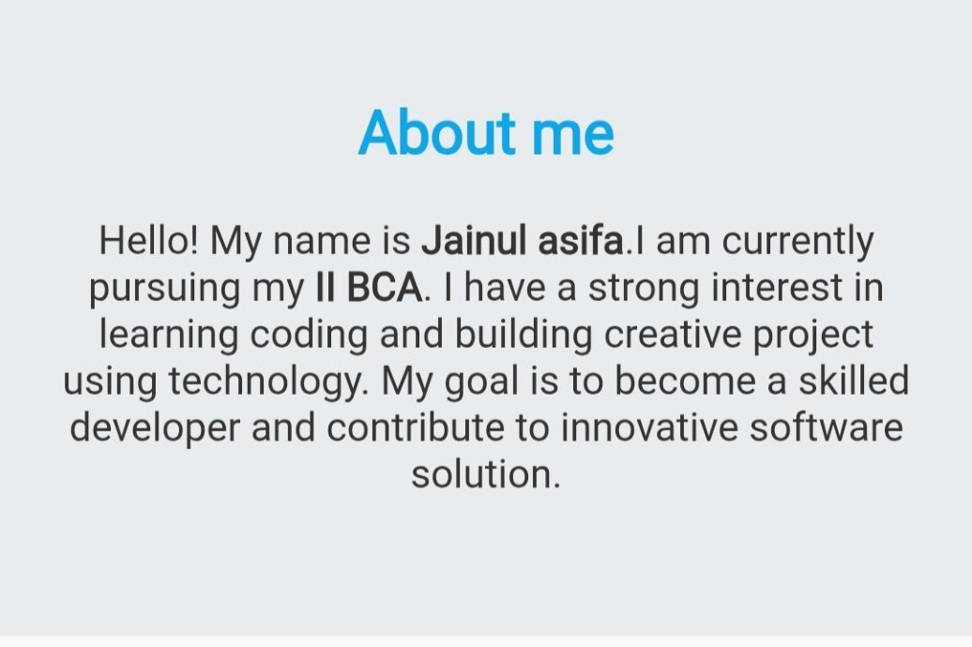
RESULT AND SCREENSHOT

Slide 15
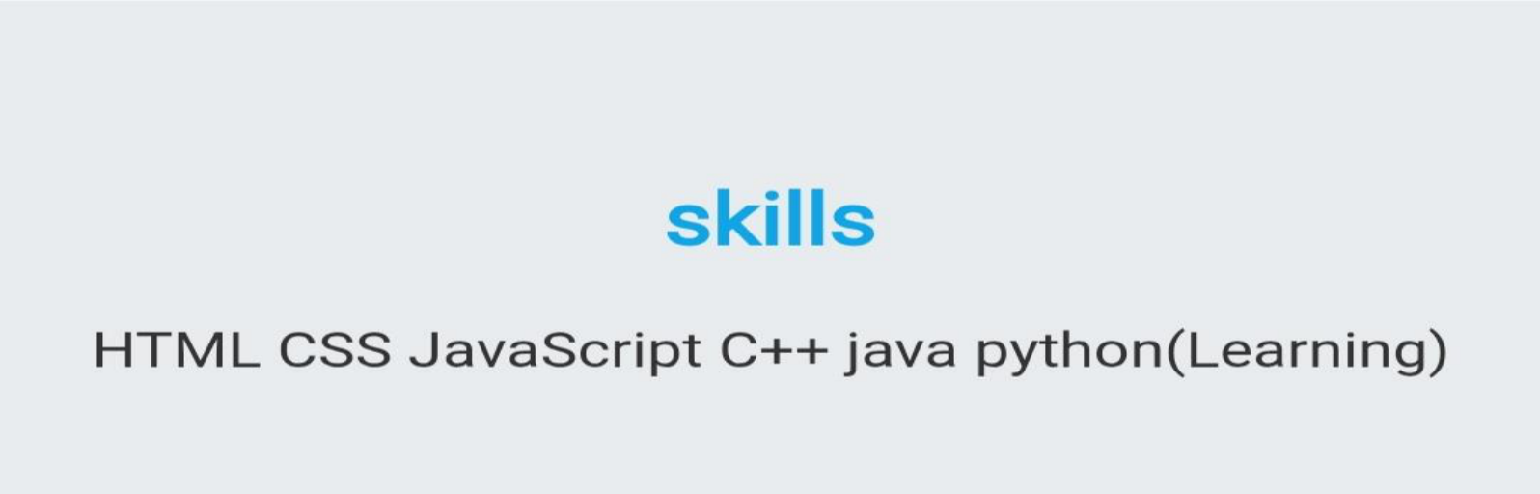
RESULT AND SCREENSHOT

Slide 16
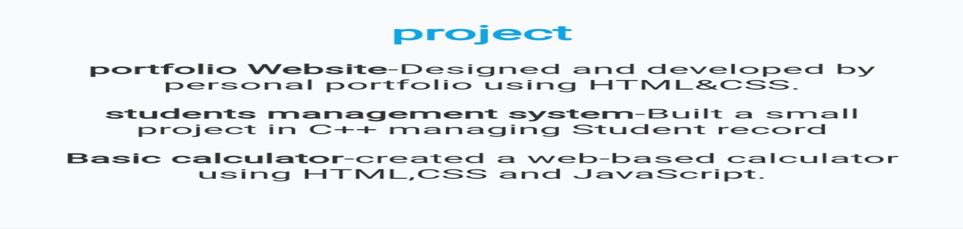
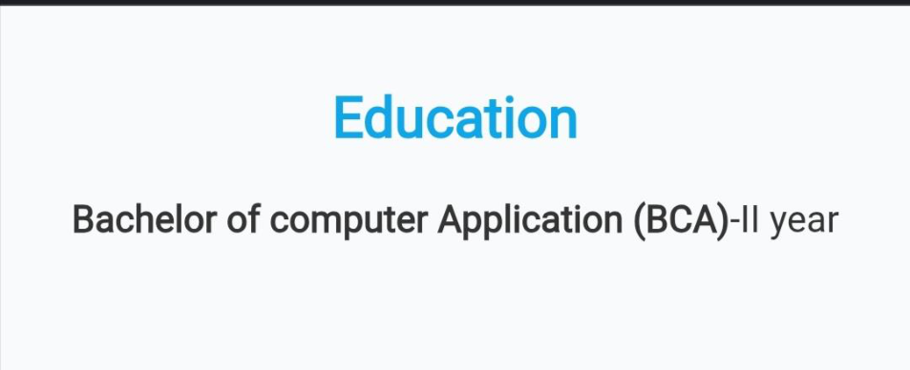
Result and screenshot

Slide 17
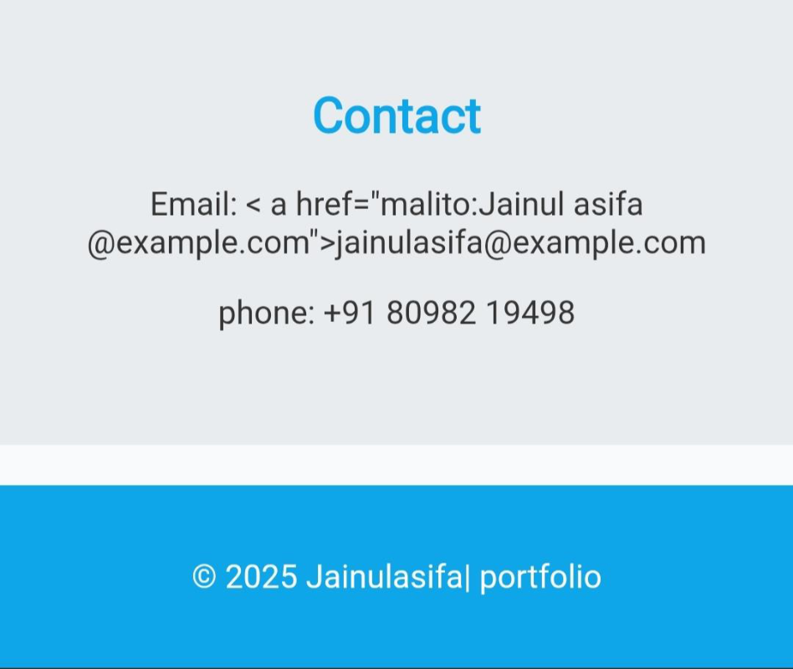
Result and screenshot

Slide 18
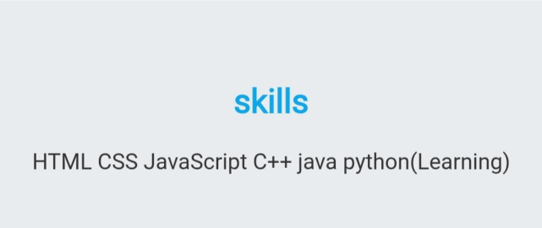

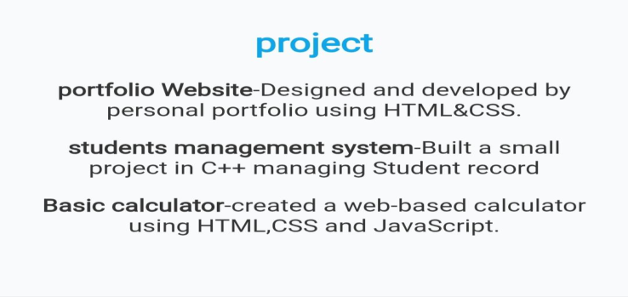


Result and screenshot

Slide 19
Conclusion
A portfolio presentation’s conclusion should recap your key strengths, achievements, and
growth as demonstrated by your work, emphasize the value and impact of your skills and
experiences, and propose clear next steps or a call to action for your audience, aligning
with the portfolio’s overall purpose and your personal or professional goals.

